Slide 1
Support Vector Machines

Slide 2
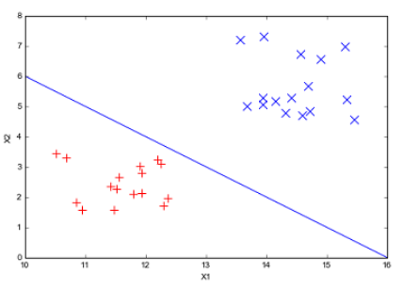
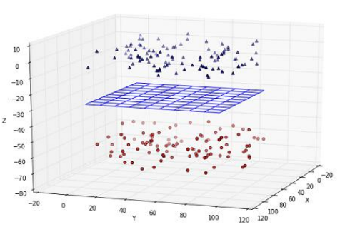
Basics
A Support Vector Machine (SVM) can be thought of as a surface that creates a boundary between points of data plotted in multidimensional space that represent examples and their feature values.

Slide 3
Contd…
This surface is often referred to as hyperplane.
Its goal is to divide the data points into somewhat fairly homogeneous partitions.
It combines aspects of both nearest neighbor methods and regression methods.
SVM algorithms have been implemented in several popular programming languages including R.

Slide 4
Contd…
SVMs can be used for both classification and numeric prediction.
Some applications of SVMs include
Classification of microarray gene expression to identify cancer or other genetic diseases.
Text categorization.
Document categorization.
Detection of events like combustion engine failure, security breaches or earthquakes.
SVMs are easily understood when used for binary classification (=> classification involving two classes).

Slide 5
SVM Classifiers
We use hyperplane to partition data into groups of similar class values.
Consider the two figures.
Hyperplanes in two – dimensions & in three – dimensions.
The hyperplanes – separate (partition) groups of circles and squares.

Slide 6
Contd…
Because the circles and squares can be separated perfectly by the straight line (two – dimension) or flat surface (three – dimension) , they are said to be linearly separable.
If all patterns in a dataset can be separated by a straight line or a hyper-plane, the dataset is said to be linearly separable.
In two – dimensions, the task of SVM algorithms is to identify a line that separates the two classes.

Slide 7
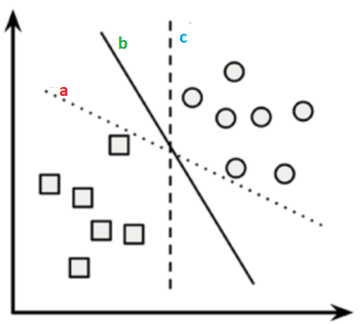
Contd…
Consider the this diagram.
Here, it is shown…three choices that divides (separates/partitions) the circles and squares.
These are a, b and c.
Which one will the algorithm choose?

Slide 8
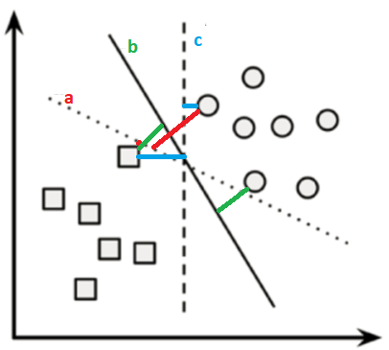


Which one…a or b or c?
The answer to this question involves the discussion on Maximum Margin Hyperplane (MMH).
It is the line / plane that creates the greatest separation between the two classes.
Assume, scaled on a cm. basis, then…
dist( , ) = 1.4 cm
dist( , )= 1.6 cm
dist( , )= 1.3 cm

Slide 9
Contd…
It seems that, in the above fig., the three lines classify the circles and squares correctly…
…but it is likely that the line that leads to the greatest separation will generalize the best to the future data.
Thus, we can say that,b is the line that can be chosen to separate the two classes (of circles and squares).
This is because, b is the MMH here.
(As the separation widens, new data points can be correctly classified.)

Slide 10
What are Support Vectors?
Consider the figure here.
Support Vectors are the points from each class that are closest
to the MMH.
Each class must have at the least one support vector.
But it is possible to have more than one support vector.
The IMPORTANT POINT is that…
 Using the support vectors alone, it is possible to define the MMH.
 Once the MMH has been defined, it is possible to perform the classification of new
data points…even if the number of features is extremely large.

Slide 11
Finding the Support Vectors…
Finding the support vectors…
depends on
Vector Geometry and,
Some tricky Mathematics.

Slide 12
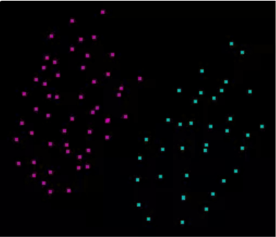
Finding the MMH…when the classes are linearly separable
A diagram of linearly separable data points is shown below.

Slide 13
Contd…
We know, MMH is the line / plane that creates the greatest
separation between the two classes.
The greatest separation is the perpendicular bisector (∴ do
this separation EQUALLY) of the shortest line between the two
convex hulls.
Convex Hull – is formed by connecting the instances of classes.
--------------------------------------------------------------------------------------------------------------------------------------------
Perpendicular Bisector – a line which is perpendicular to a given line segment and divides it into two equal halves is called a perpendicular bisector.

Slide 14
Contd…
In this FIRST METHOD
We use sophisticated computer algorithms that use a technique known as quadratic optimization to find the MMH.

Slide 15
Contd…
In the SECOND METHOD
an algorithm searches through the space of every possible hyperplanes in order TO FIND A SET OF PARALLEL PLANES that divide the points into homogeneous groups yet themselves are as far apart as possible.
NOTE: The next few slides tell us how to find such parallel planes H1 and H2.

Slide 16

Contd…
In n – dimensional space, the following equation is used to represent a hyperplane.
indicates that w is a vector of n weights. i.e., {w₁, w₂, w₃, …, w_{n}}.
is a single number known as a bias.
NOTE: b is conceptually equivalent to the intercept term in y = mx + c.

Slide 17
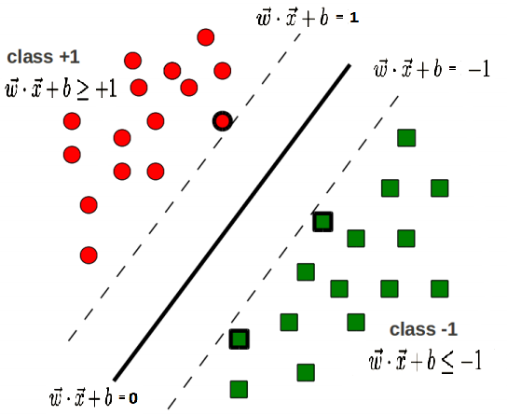
Contd…
Using this formula, the goal is to find a set of weights that specify two hyperplanes, as follows…

Slide 18
Contd…
It is required that…
all the points of one class fall above the first hyperplane and,
all the points of the other class fall beneath the second hyperplane.
This is possible as long as the data are linearly separable.

Slide 19
Contd…
Vector geometry defines the distance between these two planes as:
Here, indicates the Euclidean norm (the distance from the origin to the vector w.)
To maximize the distance between the two planes, we need to minimize .
This task is reexpressed as a set of constraints, as follows.

Slide 20
Contd…
MEANING OF:
Minimize the Euclidean norm (which is now shown to be, squared and divided by 2 to make calculations easier.)
The second line says that, this minimization is subject to the condition that, each of the y_{i} data points is correctly classified. Note that y_{i} can be transformed either to +1 or -1.
---------------------------------------------------------------------------------------------------------------------------------------
i.e., two hyperplanes H₁ and H₂ will be selected ONLY IF their norm is minimized and that too is subject to the correct classification of data points to class +1 (above H₁) and class -1 (below H₂).

Slide 21
Contd…
In this SECOND METHOD also
We use sophisticated computer algorithms that use a technique known as quadratic optimization to find the solution to this problem.

Slide 22
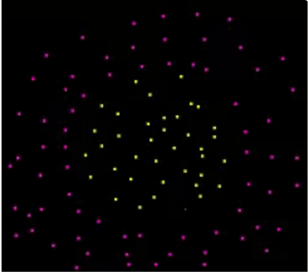
Finding the MMH…when the classes are non linearly separable
A diagram of non-linearly separable data points is shown below.

Slide 23
Contd…
Here, the solution is to use a slack variable which creates a soft margin.
The idea is to permit (allow) some misclassifications.
The image to the right side shows two points falling on the incorrect side of the margin.

Slide 24
Contd…
A cost value (denoted as C) is applied to all points that violate the constraints.
Rather than finding the maximum margin, the algorithm attempts to minimize the total cost.
The revised optimization problem is to:
----------------------------------------------------------------------------------------------------------------------------------------
NOTE: We are having SVM packages in all Statistical programming languages to implement these.

Slide 25
Contd…
MEANING OF:
Modifying the value of C will adjust the penalty – i.e., reduce the misclassification issue.
The greater the cost parameter C, the harder the optimization will try to achieve 100% separation.
A lower C value, will have a tendency for points to move to the incorrect side of the margin.
To generalize future data, it is better to strike a balance between these two.

Slide 26
The Kernel Trick
The kernel trick helps the non-linear data points suddenly to become linear.
The kernel trick uses the inherent ability of SVMs to achieve this.
That is, the SVMs are able to map the (given) problem into a higher dimensional space.
This is explained using an example.

Slide 27
Contd…
The scatterplot on the LHS depicts a non – linear relationship between a weather class and two features.
Weather class: 1. Sunny 2. Snowy
Two features: 1. Latitude 2. Longitude

Slide 28
Contd…
Data could have been generated from a set of weather reports…
Some of the weather reports were obtained from stations near the top of a mountain…
Some of the weather reports were obtained from stations around the base of a mountain…

Slide 29
Contd…
The scatterplot on the RHS, depicts a linear relationship between the weather class and its features.
This linearity has been got after the kernel trick has been applied. For this, data has been shown with a new dimension: Altitude.

Slide 30
Contd…
In the LHS plot, we are viewing the mountain from a bird’s eye view.
In the RHS plot, we are viewing the mountain from a distance at the ground level.
Now it is clear…that…snowy weather is found at higher altitudes…

Slide 31
Contd…
Thus it is clear that…
When SVMs with non-linear relationships are added with additional dimensions (features), clear separations can be generated…

Slide 32
Contd…
Thus, the KERNEL TRICK INVOLVES the PROCESS OF CONSTRUCTING NEW FEATURES (for eg: “Altitude”) that express mathematical relationships between measured characteristics.
For example, the Altitude feature can be expressed mathematically as an interaction between latitude and longitude – the closer the point is to the center of each of these scales (latitude and longitude), the greater is the altitude.

Slide 33
Contd…
The general format of Kernel functions is as follows.
Here, it is the dot product of two vectors that returns a single number as the result.
This Greek letter φ is a mapping of the data into another space.
There are a number of commonly used kernel functions in use today. Nearly all Statistical programming languages include implementable functions for these kernels.

Slide 34
Contd…
Commonly used Kernel functions are listed below.
Function Name | Actual Function
Linear Kernel
Polynomial Kernel
Sigmoid Kernel
Gaussian RBF Kernel

Slide 35
Contd…
Which Kernel function to choose?
No specific rule…for the selection of the function…
The fit depends on
the concept to be learned…
the amount of training data…
the relationships among the features…

Slide 36
Strengths Vs. Weaknesses of SVM Modeling
STRENGTHS | WEAKNESSES
Can be used for both classification and numeric prediction. | Finding the best SVM model requires testing of various combinations of kernel functions and model parameters.
Not overly influenced by noisy data. | Can be slow to train, particularly when the input dataset has a larger number of features or examples.
Not very prone to overfitting. | Results in a complex black box model that is difficult to interpret.
There are a number of Standard SVM algorithms in existence. Therefore, SVM methods are more easier and popular than Neural network modeling.
High Accuracy is there in results. Thus, gaining more popularity.

Slide 37
References
1.Machine Learning with R, Second Edition, Brett Lantz, PACKT Publishing.

